Slide 1
Studies Identifying Contaminants of Emerging Concern in Groundwater and Surface Water
Northwestern Water Planning Alliance
January 28, 2020
Amy Gahala
Hydrologist
U.S. Geological Survey
agahala@usgs.gov

Slide 2
OVERVIEW
Pharmaceuticals
Perfluoroalkanes
Microplastics

Slide 3
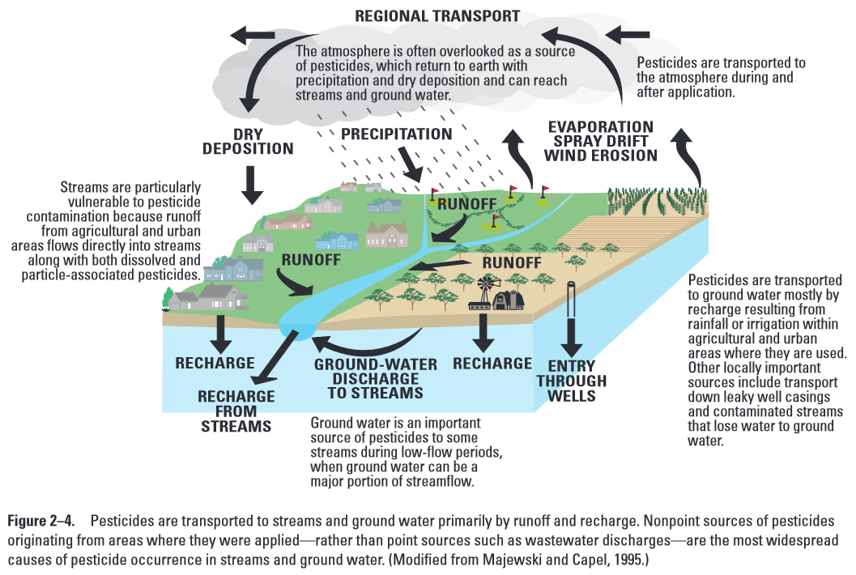
The Hydrologic Cycle and Groundwater Vulnerability
Pharmaceuticals, road salt, land use contaminants
Source: Water Science School, Pesticides in Groundwater, https://www.usgs.gov/special-topic/water-science-school/science/pesticides-groundwater?qt-science_center_objects=0#qt-science_center_objects
Notes:
Overview of hydrologic cycle noting how contaminants can enter through various pathways within the hydrologic cycle.
Aquifers are vulnerable to contamination of pharmaceuticals, road salt, pesticides, and emerging contaminants of concern

Slide 4
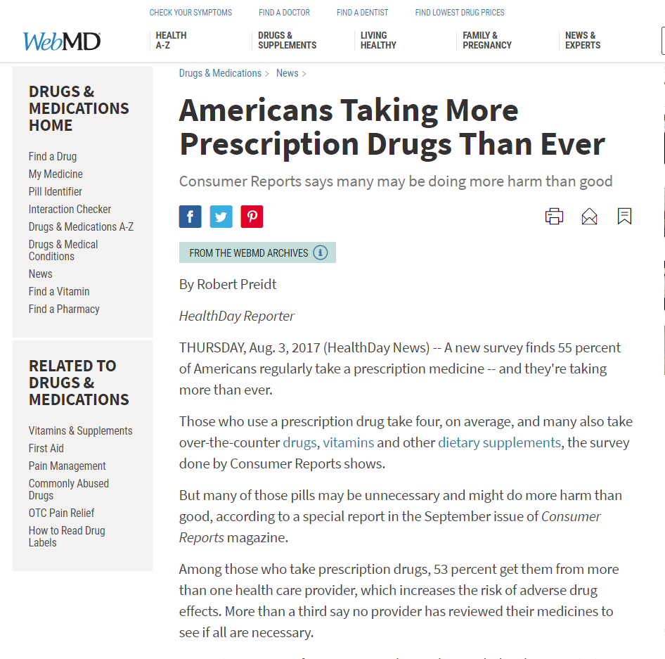
Pharmaceuticals
Vicodin
Simvastatin
Lisinopril
Levothyroxine
Azithromycin
Metformin
Lipitor
Amlodipine
Amoxicillin
Hydrochlorothiazide
https://www.medicinenet.com/top_drugs_prescribed_in_the_us/views.htm

Slide 5
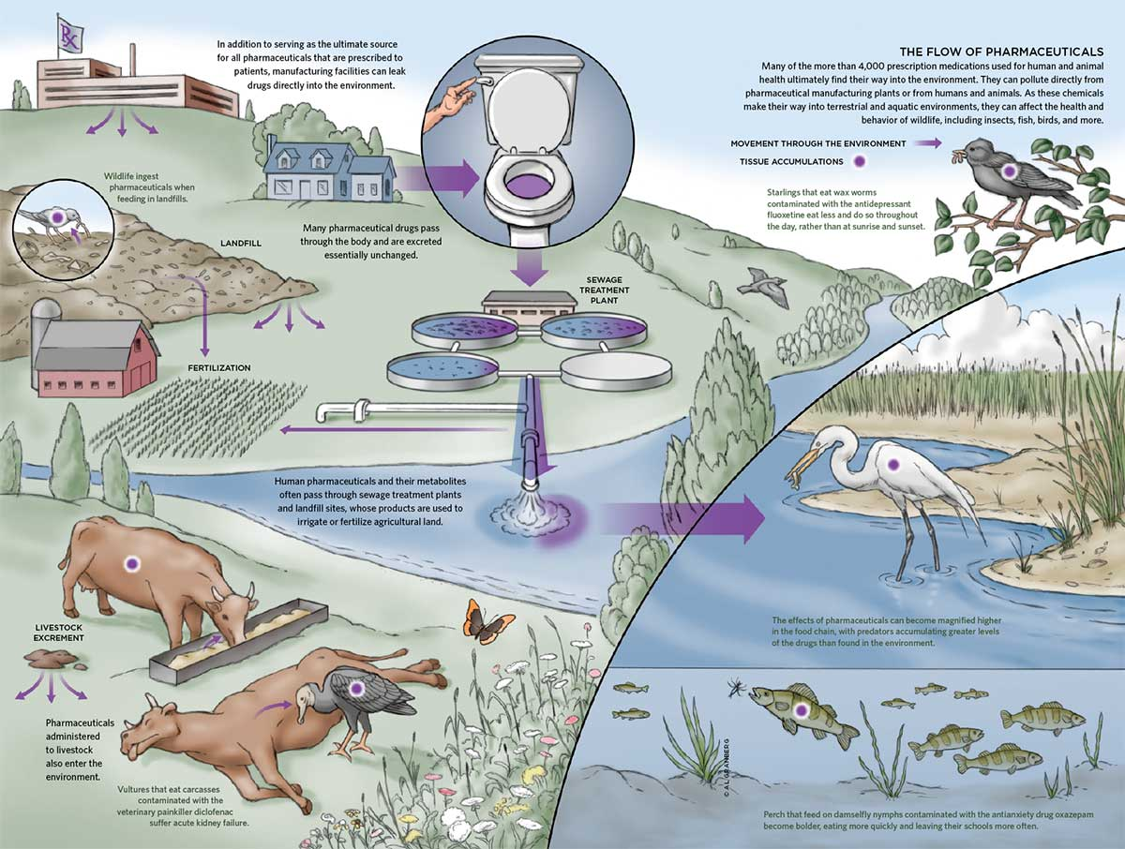
Cycling of Pharmaceuticals in the Environment
Source: Granberg, https://www.usgs.gov/media/images/pharmaceuticals-move-throughout-aquatic-environment

Slide 6
Pharmaceuticals Detected in Private Drinking Water Supplies in Shallow Aquifers
Tested 20 domestic drinking water wells for 117 organic wastewater compounds
PFASs, pharmaceuticals, and artificial sweetener detected most frequently
Nitrate, boron, and well depth correlate with PFAS and pharmaceutical detections
Septic Systems are likely main source, but landfills also
SOURCE: Laurel A. Schaider, Janet M. Ackerman, Ruthann A. Rudel
Septic systems as sources of organic wastewater compounds in domestic drinking water wells in a shallow sand and gravel aquifer
Science of The Total Environment, Volume 547, 2016, pp. 470-481
Source: Laurel A. Schaider, Ruthann A. Rudel, Janet M. Ackerman, Sarah C. Dunagan, Julia Green Brody
Pharmaceuticals, perfluorosurfactants, and other organic wastewater compounds in public drinking water wells in a shallow sand and gravel aquifer
Science of The Total Environment, Volumes 468–469, 2014, pp. 384-393

Slide 7
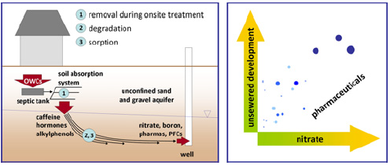
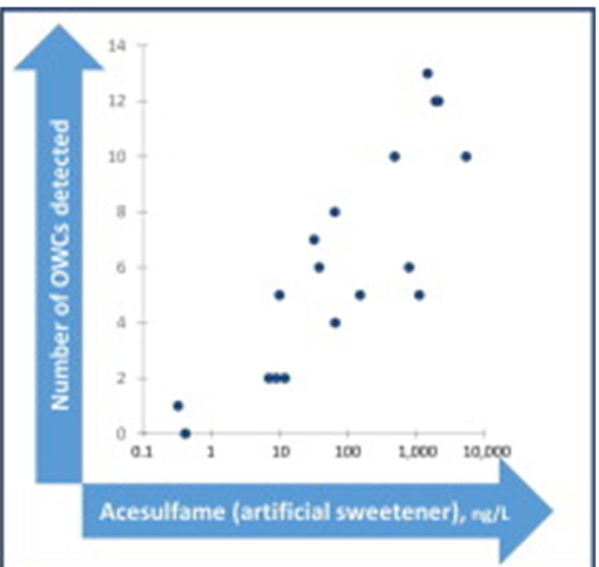
Pharmaceuticals and other Organic Waste Compounds Detected in Private Drinking Water Supplies in Shallow Aquifers
17 wells, (85%) contained detectable concentrations of at least one Organic Waste Compounds (OWC)
Acesulfame- a marker for waste water contamination
Detections are in parts per trillion
SOURCE: Laurel A. Schaider, Janet M. Ackerman, Ruthann A. Rudel
Septic systems as sources of organic wastewater compounds in domestic drinking water wells in a shallow sand and gravel aquifer
Science of The Total Environment, Volume 547, 2016, pp. 470-481
Source: Laurel A. Schaider, Ruthann A. Rudel, Janet M. Ackerman, Sarah C. Dunagan, Julia Green Brody
Pharmaceuticals, perfluorosurfactants, and other organic wastewater compounds in public drinking water wells in a shallow sand and gravel aquifer Science of The Total Environment, Volumes 468–469, 2014, pp. 384-393

Slide 8
Pharmaceuticals and other OWC Detected in Public Drinking Water Supplies in Shallow Aquifers
Tested 20 Public wells (raw water) in sand and gravel for 92 OWC
Pharmaceuticals and PFAS most frequently detected
Septic systems primary source into aquifer
Nitrate, boron, and extent of unsewered development correlate with OWC presence.
Boron is surrogate for waster water tracer (present in soaps/detergents)
SOURCE: Laurel A. Schaider, Janet M. Ackerman, Ruthann A. Rudel
Septic systems as sources of organic wastewater compounds in domestic drinking water wells in a shallow sand and gravel aquifer
Science of The Total Environment, Volume 547, 2016, pp. 470-481
Source: Laurel A. Schaider, Ruthann A. Rudel, Janet M. Ackerman, Sarah C. Dunagan, Julia Green Brody
Pharmaceuticals, perfluorosurfactants, and other organic wastewater compounds in public drinking water wells in a shallow sand and gravel aquifer Science of The Total Environment, Volumes 468–469, 2014, pp. 384-393

Slide 9
Pharmaceuticals and other OWC Detected in Public Drinking Water Supplies in Shallow Aquifers
15 wells, (75%) contained least one Organic Waste Compounds (OWC)
60% antibiotics
40% PFAS
boron as markers for waste water
Detections are in parts per trillion
SOURCE: Laurel A. Schaider, Janet M. Ackerman, Ruthann A. Rudel
Septic systems as sources of organic wastewater compounds in domestic drinking water wells in a shallow sand and gravel aquifer
Science of The Total Environment, Volume 547, 2016, pp. 470-481
Source: Laurel A. Schaider, Ruthann A. Rudel, Janet M. Ackerman, Sarah C. Dunagan, Julia Green Brody
Pharmaceuticals, perfluorosurfactants, and other organic wastewater compounds in public drinking water wells in a shallow sand and gravel aquifer Science of The Total Environment, Volumes 468–469, 2014, pp. 384-393

Slide 10
Pharmaceuticals and Other Chemicals in Landfill Waste
Sampled fresh (before storage or treatment) landfill leachate from 19 landfills across the United States
12 municipal
7 private
Tested for 202 contaminants of emerging concern (CEC)
Industrial chemical, prescription pharmaceuticals, household chemicals, and nonprescription pharmaceuticals most frequently detected
Landfills receiving greater precipitation had greater frequency of CEC detections
SOURCE: Contaminants of emerging concern in fresh leachate from landfills in the conterminous United States: Environmental Science--Processes and Impacts, 2014, v. 16, no. 10, p. 2335-2354, doi:10.1039/C4EM00124A. https://toxics.usgs.gov/highlights/2014-08-12-leachate_pharm.html
Notes:
No landfills in BACOG area, but there are several in the surrounding region.
Contaminants of emerging concern in fresh leachate from landfills in the conterminous United States: Environmental Science--Processes and Impacts, 2014, v. 16, no. 10, p. 2335-2354, doi:10.1039/C4EM00124A. https://toxics.usgs.gov/highlights/2014-08-12-leachate_pharm.html

Slide 11
Pharmaceuticals and Other Chemicals in Landfill Waste
SOURCE: Contaminants of emerging concern in fresh leachate from landfills in the conterminous United States: Environmental Science--Processes and Impacts, 2014, v. 16, no. 10, p. 2335-2354, doi:10.1039/C4EM00124A. https://toxics.usgs.gov/highlights/2014-08-12-leachate_pharm.html
Notes:
Contaminants of emerging concern in fresh leachate from landfills in the conterminous United States: Environmental Science--Processes and Impacts, 2014, v. 16, no. 10, p. 2335-2354, doi:10.1039/C4EM00124A. https://toxics.usgs.gov/highlights/2014-08-12-leachate_pharm.html

Slide 12
Pharmaceuticals in Landfill Leachate Disposed to Wastewater Treatment Plants
Sampled final (after storage or treatment processes) landfill leachate from 22 landfills across the United States
Tested for 190 contaminants of emerging concern (CEC)
All samples detected CECs
Detected 101 different CECs: 43, prescription pharmaceuticals, 22 industrial chemicals, 15 household chemicals, and 12 nonprescription pharmaceuticals most frequently detected
Final leachate from active landfills had significantly greater CEC concentrations from modern lined landfills than unlined, closed landfills.
SOURCE: https://toxics.usgs.gov/highlights/2015-11-13-leachate_pathways.html
SOURCE: Masoner, J.R., Kolpin, D.W., Furlong, E.T., Cozzarelli, I.M., and Gray, J.L., 2015, Landfill leachate as a mirror of today's disposable society--Pharmaceuticals and other contaminants of emerging concern in final leachate from landfills in the conterminous United States: Environmental Toxicology and Chemistry, doi:10.1002/etc.3219 (Advanced Web release).
Masoner, J.R., Kolpin, D.W., Furlong, E.T., Cozzarelli, I.M., Gray, J.L., and Schwab, E.A., 2014, Contaminants of emerging concern in fresh leachate from landfills in the conterminous United States: Environmental Science--Processes and Impacts, v. 16, no. 10, p. 2335-2354, doi:10.1039/C4EM00124A.
Notes:
Leachate is the chemical soup created by the decay of organic matter and infiltration of rain that carries various organics and inorganic chemistries. In modern landfills, the leachate is collected and treated at a WWTP. In older, unlined landfills, this leachate can affect the local groundwater.
Most frequent detections: lidocaine (local anesthetic), cotinine (nicotine breakdown product), carisoprodol (muscle relaxant) bisphenol A (plastics component), carbamazepine (anticonvulsant), DEET.
leachate released
53% (101 of 190) contaminants of emerging concern were detected in the leachate
.
Concentrations ranged from 2 – 17,200,000 ng/L.

Slide 13
Pharmaceuticals in Landfill Leachate Disposed to Wastewater Treatment Plants
Most Frequent Detections:
Lidocaine | Local anesthetic
Cotinine | Nicotine breakdown products
Carisoprodol | Muscle relaxant
Bisphenol A | Plastics component
carbamazepine | Anticonvulsant
DEET | Insect repellent
SOURCE: https://toxics.usgs.gov/highlights/2015-11-13-leachate_pathways.html
SOURCE: Masoner, J.R., Kolpin, D.W., Furlong, E.T., Cozzarelli, I.M., and Gray, J.L., 2015, Landfill leachate as a mirror of today's disposable society--Pharmaceuticals and other contaminants of emerging concern in final leachate from landfills in the conterminous United States: Environmental Toxicology and Chemistry, doi:10.1002/etc.3219 (Advanced Web release).
Masoner, J.R., Kolpin, D.W., Furlong, E.T., Cozzarelli, I.M., Gray, J.L., and Schwab, E.A., 2014, Contaminants of emerging concern in fresh leachate from landfills in the conterminous United States: Environmental Science--Processes and Impacts, v. 16, no. 10, p. 2335-2354, doi:10.1039/C4EM00124A.
Notes:
There are WWTP in Barrington and the LBS subdivision, but most have septic.
Leachate is the chemical soup created by the decay of organic matter and infiltration of rain that carries various organics and inorganic chemistries. In modern landfills, the leachate is collected and treated at a WWTP. In older, unlined landfills, this leachate can affect the local groundwater.
Most frequent detections: lidocaine (local anesthetic), cotinine (nicotine breakdown product), carisoprodol (muscle relaxant) bisphenol A (plastics component), carbamazepine (anticonvulsant), DEET.
leachate released
53% (101 of 190) contaminants of emerging concern were detected in the leachate
.
Concentrations ranged from 2 – 17,200,000 ng/L.

Slide 14
Pharmaceuticals Found in Treated Wastewater can be Transported from Surface Water to Groundwater
Wastewater effluent contributing 99 and 71 percent of the flow within creek sampled two periods, October and December of 2012
Stream and shallow groundwater samples collected and analyzed for 110 pharmaceuticals.
42 (Oct.) and 55 (Dec.) percent of samples detected pharmaceuticals
USGS study: Riverbank filtration potential of pharmaceuticals in a wastewater-impacted stream: Environmental Pollution, 2014, v. 193, p. 173-180, doi:10.1016/j.envpol.2014.06.028.
Notes:
Analysis of stream-water samples collected downstream of wastewater effluent discharge revealed that 43 - 55 percent of pharmaceuticals analyzed were detected during sampling events.
Relatively fewer pharmaceuticals were detected in shallow groundwater. However, 6-16 percent were detected at a distance of 20 meters (65 ft) from the stream bank.
The pharmaceuticals detected 20 meters from the stream bank included antivirals and antibiotics, muscle relaxants, and antidepressants and tranquilizers, as well as medications for treating cancer, diabetes, and hypertension; their concentrations as high as 87 nanograms per liter (ng/L).
The anticonvulsant and an antibacterial drug, sulfamethoxazole were primarily detected.

Slide 15
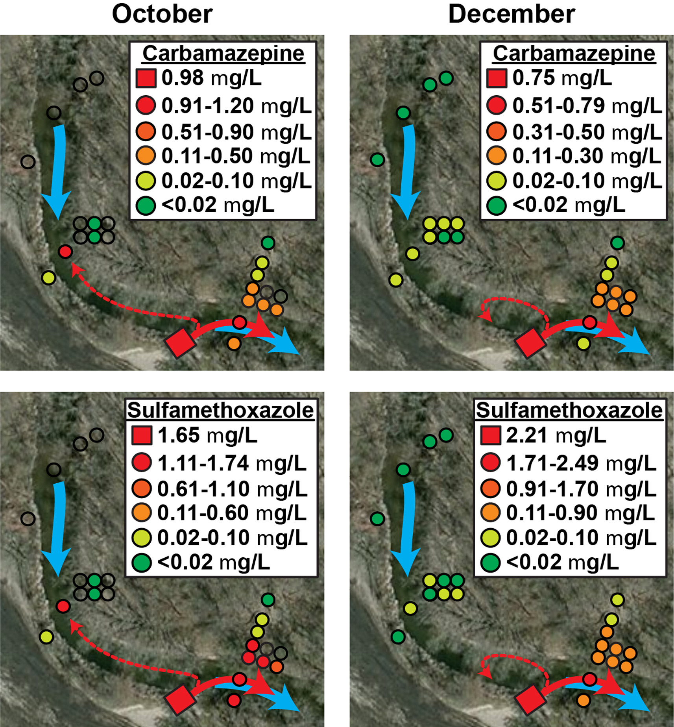
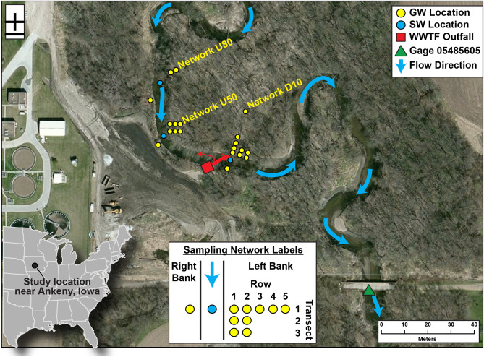
Pharmaceuticals Found in Treated Wastewater can be Transported from Surface Water to Groundwater
USGS study: Riverbank filtration potential of pharmaceuticals in a wastewater-impacted stream: Environmental Pollution, 2014, v. 193, p. 173-180, doi:10.1016/j.envpol.2014.06.028.
Notes:
Analysis of stream-water samples collected downstream of wastewater effluent discharge revealed that 43 - 55 percent of pharmaceuticals analyzed were detected during sampling events.
Relatively fewer pharmaceuticals were detected in shallow groundwater. However, 6-16 percent were detected at a distance of 20 meters (65 ft) from the stream bank.
The pharmaceuticals detected 20 meters from the stream bank included antivirals and antibiotics, muscle relaxants, and antidepressants and tranquilizers, as well as medications for treating cancer, diabetes, and hypertension; their concentrations as high as 87 nanograms per liter (ng/L).
The anticonvulsant and an antibacterial drug, sulfamethoxazole were primarily detected.

Slide 16
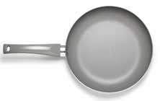
PerfluoroWhat?
PFAS is a broad name for man-made industrial chemicals
Nonstick cookware, firefighting foams, food wrappers, stain and water resistant fabrics, household cleaners
These chemicals are
Oil and water repellent
Extremely persistent
Bioaccumulate
Photo sources: https://www.rnz.co.nz/news/environment/397591/banned-firefighting-foam-found-at-port-taranaki-dunedin-airport
https://chemicalwatch.com/76146/precise-genx-mechanism-of-toxicity-eludes-epa-scientists
Notes:
https://www.rnz.co.nz/news/environment/397591/banned-firefighting-foam-found-at-port-taranaki-dunedin-airport
https://chemicalwatch.com/76146/precise-genx-mechanism-of-toxicity-eludes-epa-scientists
PFOS and PFOA are fully fluorinated, organic compounds. They are the two PFASs that have been produced in the largest amounts within the United States PFOS/PFOA- perfluorooctane sulfonate and perfluorooctanoic acid

Slide 17
Potential Health Effects
Studies associate PFOS and PFOA in exposure with high cholesterol, thyroid disorders, preeclampsia, and testicular and kidney cancer, reproductive and developmental effects.
Confirmed animal carcinogen at parts per trillion level
That is equivalent to 1 ounce in 7.5 billion gallons of water
In blood of general human and wildlife population
USEPA Fact Sheet: https://www.epa.gov/sites/production/files/2017-12/documents/ffrrofactsheet_contaminants_pfos_pfoa_11-20-17_508_0.pdf
Notes:
In blood of general human and wildlife population
USEPA Fact Sheet: https://www.epa.gov/sites/production/files/2017-12/documents/ffrrofactsheet_contaminants_pfos_pfoa_11-20-17_508_0.pdf

Slide 18
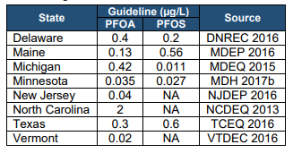
Are PFOS and PFOAs regulated?
Federally NOT regulated: NO Maximum Contaminant Level (MCL) established by USEPA
Some States have established drinking water standards

Slide 19
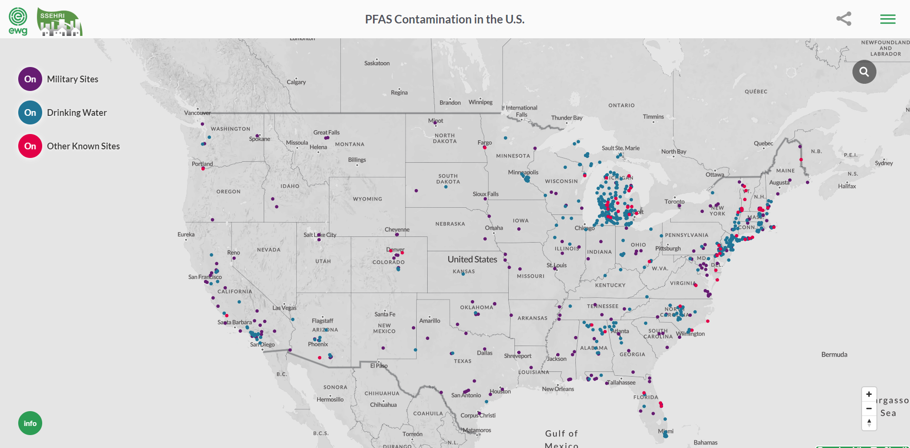
PFAS Detected in Drinking Water and Groundwater
Source: https://www.ewg.org/interactive-maps/2019_pfas_contamination/map/
Notes:
Basically, PFAS compounds are detected everywhere we look. The more we look, the more we find.
This map is not all-inclusive.

Slide 20
Illinois PFAS Study
Illinois Environmental Protection Agency is testing municipal water supplies for PFAS compounds throughout the State (2020-2021).
Illinois has not established a standard.
Defer to USEPA Lifetime Health Advisory of 70 nanograms per liter (ng/L) or parts per trillion (ppt).
Source: https://pfas-1.itrcweb.org/wp-content/uploads/2018/01/pfas_fact_sheet_regulations__1_4_18.pdf
Notes:
Illinois PFAS Study
Source: https://pfas-1.itrcweb.org/wp-content/uploads/2018/01/pfas_fact_sheet_regulations__1_4_18.pdf

Slide 21
Microplastics are Everywhere!
Plastic does not biodegrade or breakdown into simple, digestible components.
Plastic simply breaks down into smaller and smaller plastic pieces, creating microplastics.
Samples collected from the St. Croix and Mississippi Rivers from water, sediment, fish, and mussels ALL contained microplastics.
Fibers were most abundant, 86 to 93 percent in the samples.
https://irma.nps.gov/DataStore/DownloadFile/577360
https://www.sciencebase.gov/catalog/item/58e7d00ae4b09da6799c0f8a
Notes:
https://advances.sciencemag.org/content/3/7/e1700782.full 79%% of plastics ever produced are accumulating in landfills and natural environments.

Slide 22
Microplastics in our Nation’s Surface Water
12% of freshwater fish have ingested plastic particles
50 – 90 particles per serving of oysters and mussels
Hazards are physical, carcinogenic, and endocrine disruption
Source: https://owi.usgs.gov/vizlab/microplastics/

Slide 23
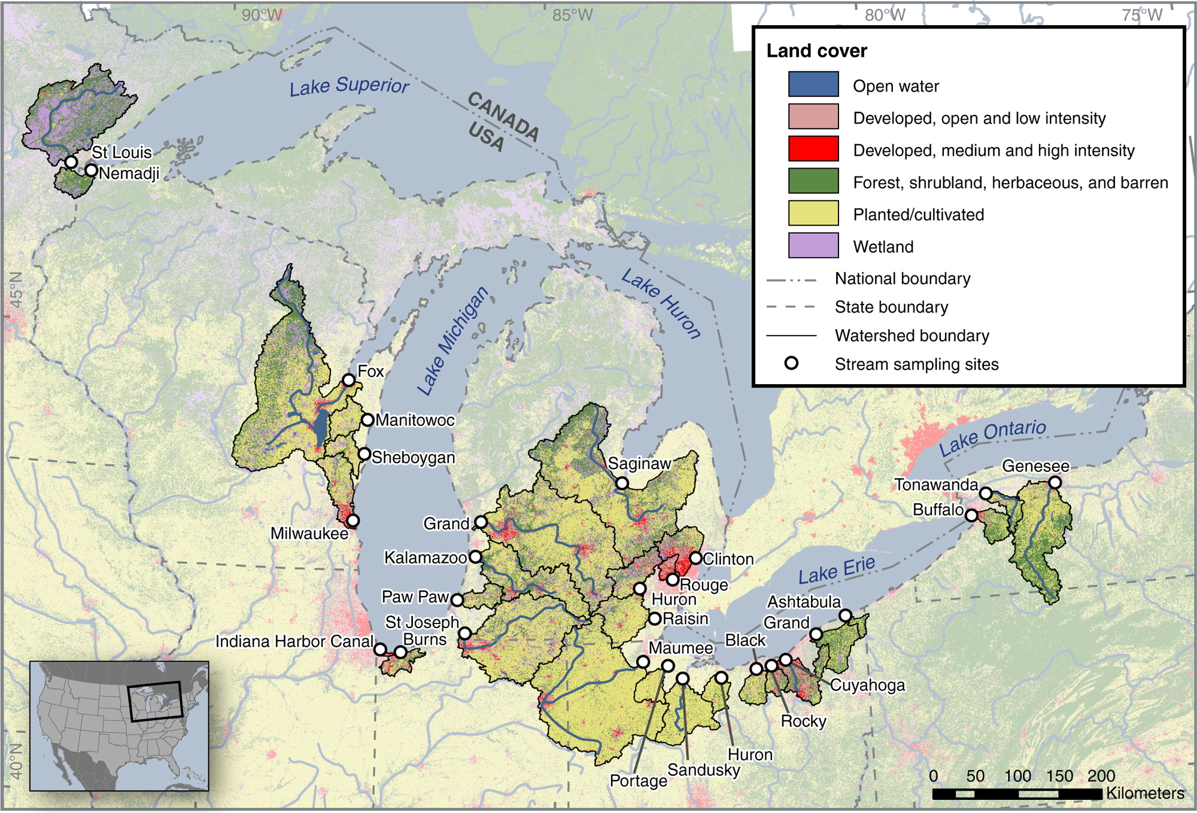
Plastic Debris in 29 Tributaries to the Great Lakes
107 samples analyzed
100% detection of plastic particles
71% fibers
17% fragments
Sampling locations, watershed boundaries, and watershed land uses.
Published in: Austin K. Baldwin; Steven R. Corsi; Sherri A. Mason; Environ. Sci. Technol. 2016, 50, 10377-10385.
DOI: 10.1021/acs.est.6b02917
Copyright © 2016 American Chemical Society
Notes:
Plastic particles were found in all 107 samples analyzed.
The most frequently occurring plastic particle type was fibers/lines,
making up on average 71% of each sample.
Fragments were the second most abundant plastic particle type,
making up on average 17% of each sample, followed by foams, films,
and pellets/beads (8%, 3%, and 2%, respectively).

Slide 24
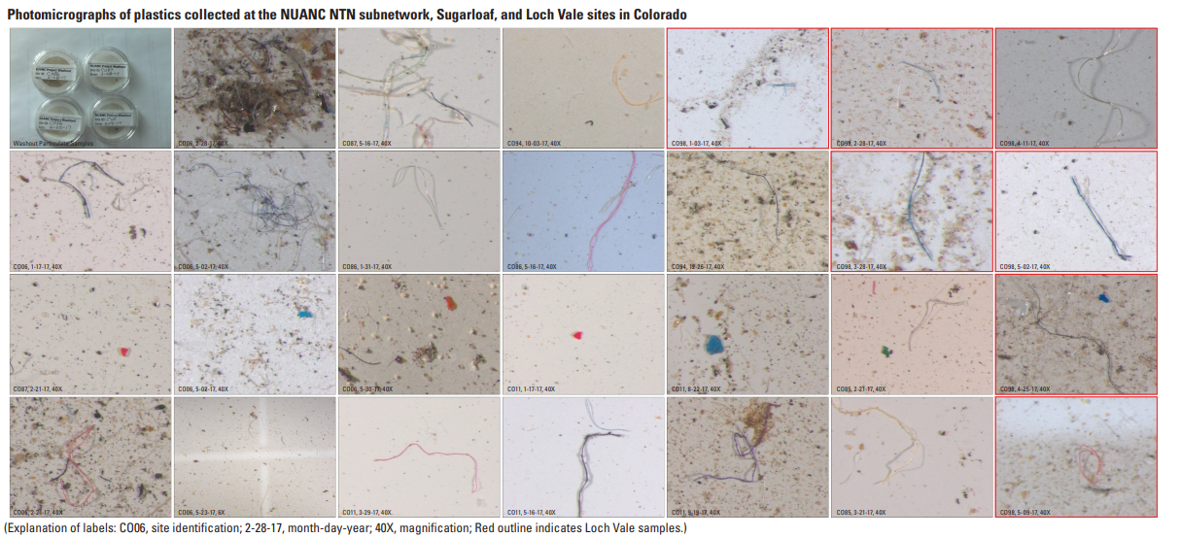
Microplastics in the Rain
Colorado Front Range peppered with microfibers and microparticles in >90 percent of samples
https://pubs.usgs.gov/of/2019/1048/ofr20191048.pdf
Notes:
Microplastics in the RAIN
Snowpacked Rocky Mountains of Colorado are peppered with microfibers and microparticles in >90 percent of samples

Slide 25
Microplastic in Groundwater
Primarily in karst aquifers which have large voids
Scientists have only just begun to explore microplastics in groundwater systems
Source: Samuel V. Panno, Walton R. Kelly, John Scott, Wei Zheng, Rachael E. McNeish, Nancy Holm, Timothy J. Hoellein, Elizabeth L. Baranski. Microplastic Contamination in Karst Groundwater Systems. Groundwater, 2019; DOI: 10.1111/gwat.12862
Notes:
that transport groundwater with little filtration by smaller particles such as silts, clays, sands, and gravel.
ISWS only study so far to have looked into microplastics in groundwater.

Slide 26
Groundwater and Surface Waters are Vulnerable
pharmaceuticals
microplastics
PFAS
Source: Water Science School, Pesticides in Groundwater, https://www.usgs.gov/special-topic/water-science-school/science/pesticides-groundwater?qt-science_center_objects=0#qt-science_center_objects
Notes:
It is up to the users and resource managers to help prevent contamination of drinking water (and surface waters).

Slide 27
USGS References
https://toxics.usgs.gov/investigations/cec/wastewater_treatment.html
https://toxics.usgs.gov/highlights/2014-09-22-pharms2gw.html
https://toxics.usgs.gov/highlights/2014-08-12-leachate_pharm.html
https://pubs.usgs.gov/fs/2007/3103/
https://pubs.er.usgs.gov/publication/70142252

