Slide 1
Statewide Sampling to Determine Spatial Distribution, Prevalence, and Occurrence of Per- and Polyfluoroalkyl Substances (PFAS) in Illinois Community Water Supplies, 2020—21
Amy M. Gahala
Hydrologist
Central Midwest Water Science Center
U.S. Geological Survey (USGS)
agahala@usgs.gov
Photo of faucet from which a finished water sample was collected. Photograph taken by Alan Fuhrman, Illinois Environmental Protection Agency.

Slide 2
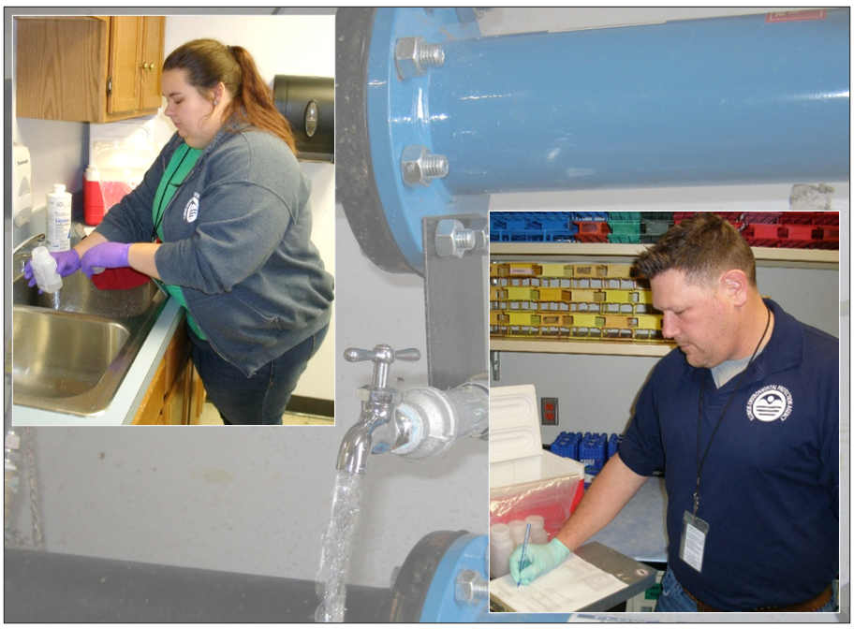
Outline
Purpose
What is PFAS?
Current regulations
What was sampled?
How many samples?
Confirmation and QC samples
Results
Summary
Gahala, A.M., Sharpe, J.B., and Williams, A.M., 2023, Statewide sampling to determine spatial distribution, prevalence, and occurrence of per- and polyfluoroalkyl substances (PFAS) in Illinois community water supplies, 2020–21: U.S. Geological Survey Scientific Investigations Report 2023–5078, 24 p., https://doi.org/ 10.3133/sir20235078.
Photograph showing a staff geologist, Illinois Environmental Protection Agency, collecting a sample from the Illinois community water supply (top left). Photograph showing a staff geologist, Illinois Environmental Protection Agency, recording sample site information of the Illinois community water supply (bottom right). Photograph showing one of the locations tested during the statewide study (background). Photographs taken by Alan Fuhrman, Illinois Environmental Protection Agency
2

Slide 3
Illinois EPA Study Purpose
The Illinois EPA undertook the investigation because it is planning to establish drinking water standards (Maximum Contaminant Levels or MCLs) for some PFAS and had little data on PFAS in public drinking water supplies in Illinois.
USGS Study Purpose
To provide third-party statistical analysis and summary of PFAS from samples collected by Illinois EPA.
occurrence
frequency
distribution
3

Slide 4
Per- and polyfluoroalkyl substances (PFAS)
PFAS is a broad name for man-made industrial chemicals used in
nonstick cookware, firefighting foams, food wrappers, stain and water-resistant fabrics, household cleaners
These chemicals are
Oil and water repellent
Extremely persistent
Able to bioaccumulate and biomagnify
Photo sources: https://www.rnz.co.nz/news/environment/397591/banned-firefighting-foam-found-at-port-taranaki-dunedin-airport
https://chemicalwatch.com/76146/precise-genx-mechanism-of-toxicity-eludes-epa-scientists
4
Notes:
https://www.rnz.co.nz/news/environment/397591/banned-firefighting-foam-found-at-port-taranaki-dunedin-airport
https://chemicalwatch.com/76146/precise-genx-mechanism-of-toxicity-eludes-epa-scientists
PFOS and PFOA are fully fluorinated, organic compounds. They are the two PFASs that have been produced in the largest amounts within the United States PFOS/PFOA- perfluorooctane sulfonate and perfluorooctanoic acid

Slide 5
Potential Adverse Health Effects
Several studies associate PFAS exposure with:
Preeclampsia
Reproductive and developmental effects
Testicular cancer
Thyroid disorders
Kidney cancer
Reduced immune function
Liver disease
Confirmed animal carcinogen at parts per trillion (ppt) level
In blood of general human and wildlife population and also detected in breastmilk
ppt is equivalent to 1 ounce in 7.5 billion gallons of water
5
Notes:
In blood of general human and wildlife population
USEPA Fact Sheet: https://www.epa.gov/sites/production/files/2017-12/documents/ffrrofactsheet_contaminants_pfos_pfoa_11-20-17_508_0.pdf

Slide 6
Sources of PFAS in the Environment
PFAS are persistent in both surface-water and groundwater environments owing to their high solubility, limited ability to bind to organic carbon, and resistance to biodegradation. Sources include:
industrial facilities
landfills
wastewater treatment plants
fire-fighting training facilities
building/roofing materials
waters with no known point sources
6

Slide 7
Remediation of PFAS
Existing Technologies
Emerging Technologies
Absorbents (activated carbon, resins)
Microbial degradation (Schulte, 2022)
Reagents (Trang and others, 2022)
Incineration
Ultrasonication
Plasma-based oxidation
Electrochemical degradation
Supercritical water oxidation
Ultraviolet-initiated degradation using additives (sulfite or iron)
Combinations.
7

Slide 8
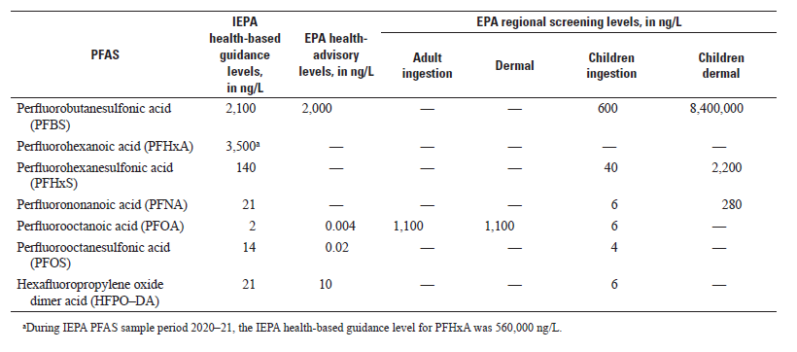
Current U.S. Regulations
In March of 2021, the EPA announced that it will develop national primary drinking-water standards and wastewater effluent standards for perfluorooctanoic acid (PFOA) and perfluorooctanesulfonic acid (PFOS).
[ng/L, nanograms per liter]
8
Notes:
The U.S. manufacturing began to decrease production of some PFAS in over the potential health and environmental effects (Interstate Technology Regulatory Council, 2020). However, PFAS are still used internationally where comprehensive regulation is lacking, and some of these products are imported to the United States often as novel molecules of PFAS-containing products that may not be detected by current laboratory instrumentation (Cousins and others, 2019; Nakayama and others, 2019
March of 2023, USEPA proposed MCLs of 4 ppt for PFOA and PFOS and a hazard index of combined four PFAS and for a mixture containing one or more of PFHxS, HFPO-DA and its ammonium salt, PFNA, PFBS as an HI of unitless 1.0.
https://www.federalregister.gov/documents/2023/03/29/2023-05471/pfas-national-primary-drinking-water-regulation-rulemakingaking

Slide 9
Illinois Environmental Protection Agency (IEPA) Regulations
The IEPA is planning to set a statewide minimum threshold to help guide public health officials in responding to PFAS contamination.
The results of this study could be used to help determine the next steps for setting a statewide maximum contaminant level in Illinois.
Information on the creation of a statewide maximum contaminant level for PFAS in Illinois can be accessed on the IEPA web page https://epa.illinois.gov/topics/water-quality/pfas.html
9

Slide 10
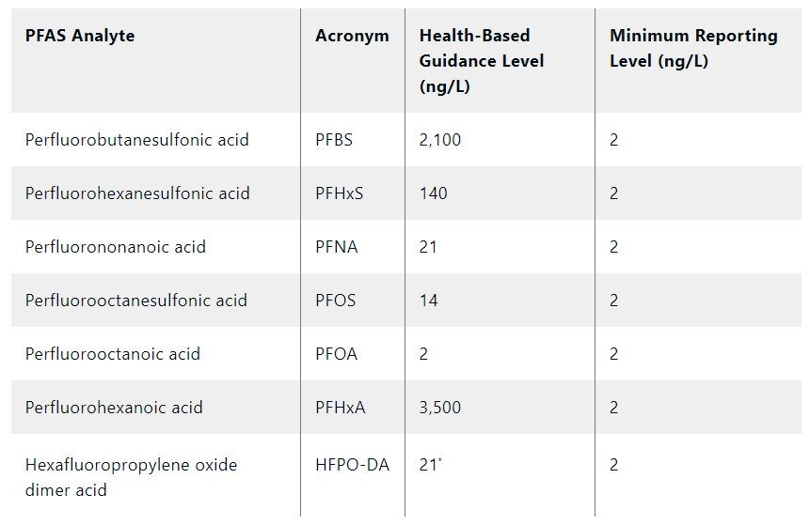
Illinois Health-Based Guidance Level
Illinois Environmental Protection Agency, 2023
10

Slide 11
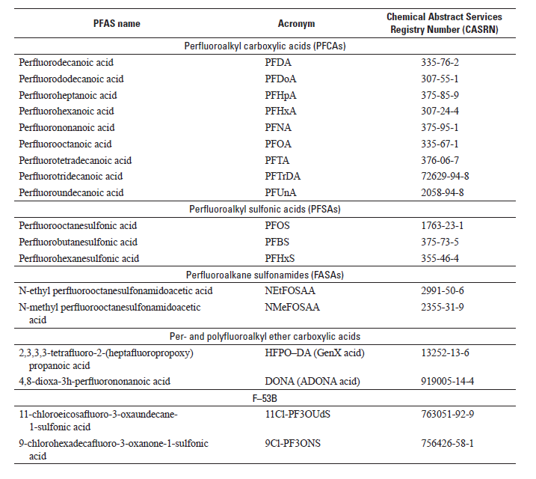
PFAS Analysis: EPA Method 537.1
(Shoemaker and Tettenhorst, 2018)
11
Notes:
A CWS system could have multiple supply wells, surface-water intakes, and entry points into the CWS distribution system. Only active entry points were sampled (that is, CWS systems that were actively treating source water and then supplying drinking water directly to the population or to other CWS systems for redistribution).

Slide 12
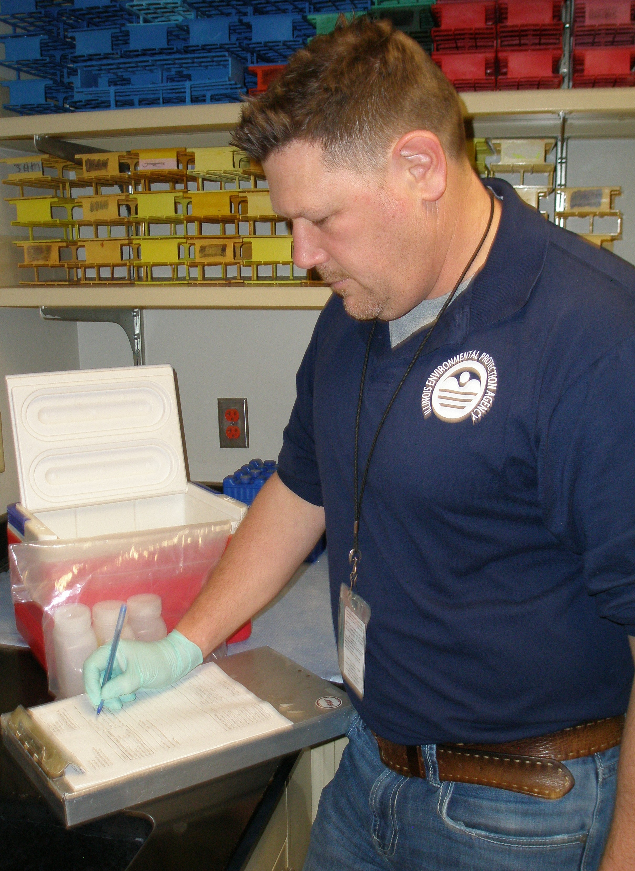
Sampling Plan of Illinois Community Water Supplies (CWS)
There are 1,749 CWS systems across Illinois with 1,456 entry points.
A CWS system could have multiple entry points from groundwater supply wells and surface water intakes into the CWS distributions system.
Only active entry points were sampled.
Finished water (treated water just before distribution).
Staff geologist, Illinois Environmental Protection Agency (IEPA), recording sample site information. Photograph taken by Alan Fuhrman, IEPA.
12

Slide 13
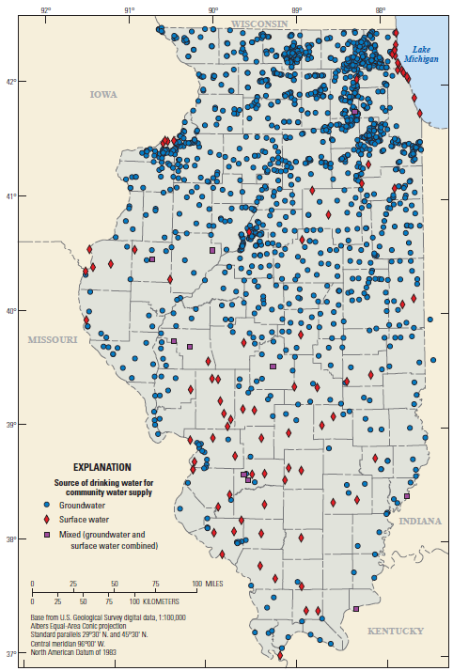
Sampling of CWS
All active entry points at each CWS system were sampled following collection methods detailed in Sampling and Analysis Plan and Quality Assurance Project Plan (Dulka and Rousey, 2020)
Unfiltered samples from finished water were collected in two-250 milliliter polypropylene bottles plus associated quality-control samples.
Samples labeled with information regarding the drinking-water source
— groundwater (GW),
— surface water (SW),
— mixed sources of surface water and groundwater (MX)
13
Notes:
The initial goal of the sampling plan was to collect samples from finished water at 1,456 entry points to the distribution system representing 1,749 CWS systems across Illinois for the analysis of PFAS. However, only active entry points were sampled (that is, CWS systems that were actively treating source water and then supplying drinking water directly to the population or to other CWS systems for redistribution). A CWS system could have multiple supply wells, surface-water intakes, and entry points into the CWS distribution system. All active entry points at each CWS system were sampled and each entry point is distinguished with a unique identification number. Initial samples represent the first sample collected at each entry point of a CWS.
If the initial sample results had any detectable PFAS, a confirmation sample was collected at those same entry points to verify the presence of that detected PFAS from the initial sampling event. If the confirmation sample did not confirm the initial detection, a secondary confirmation sample was collected. The results of the third sample helped determine whether PFAS was confirmed at that sample location. The type of PFAS detected at or above the HBGL were also considered for additional confirmation sampling. One or more of the same PFAS repeatedly detected in at least two sampling events indicated the sample site and water system both were categorized as confirmed detections.
Ultimately, the IEPA collected 1,711 unfiltered field samples (includes quality-control samples) of finished water at active entry points (that is, water entering the system of pipes used to distribute drinking water to the customer) between September 2020 and December 2021 at 1,017 Illinois CWS systems (fig. 1) for the analysis of PFAS. Of the 1,711 total samples collected, 1,428 were initial field samples, 164 samples were confirmation samples, 33 were secondary confirmation samples, and the remainder were duplicate.

Slide 14
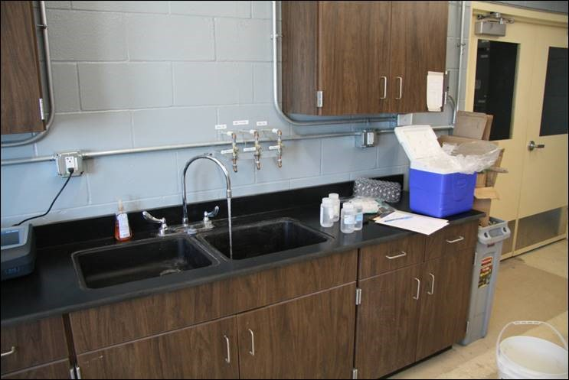
Confirmation Samples
If the initial sample results had any detectable PFAS, a confirmation sample was collected at those same entry points to verify the presence of that detected PFAS from the initial sampling event.
Secondary confirmation samples collected at locations with different PFAS detected from the initial, and if the confirmation sample did not confirm what was in the initial sample.
One or more of the same PFAS repeatedly detected in at least two sampling events indicated the sample site and water system both were categorized as confirmed detections.
Photograph of entry-point sampling point of finished drinking water at CWS, taken by Alan Fuhrman, IEPA
14
Notes:
Sampling methods and Quality control
Sample collection methods followed the SOP contained in the IEPA QAPP (Dulka and Rousey, 2020; IEPA, 2020). According to the SOP and QAPP, each sample set from a unique entry point consisted of a minimum of an unfiltered field sample (two 250-milliliter polypropylene bottles) and a field reagent blank (FRB) (one bottle). Precision and bias were measured by collecting additional samples for field duplicates and laboratory fortified sample matrix (LFSM)/LFSM duplicate (LFSMD) per batch of 20 field sample sets. A total of 86 field duplicate samples and 75 LFSM/LFSMD samples were collected in this study.

Slide 15
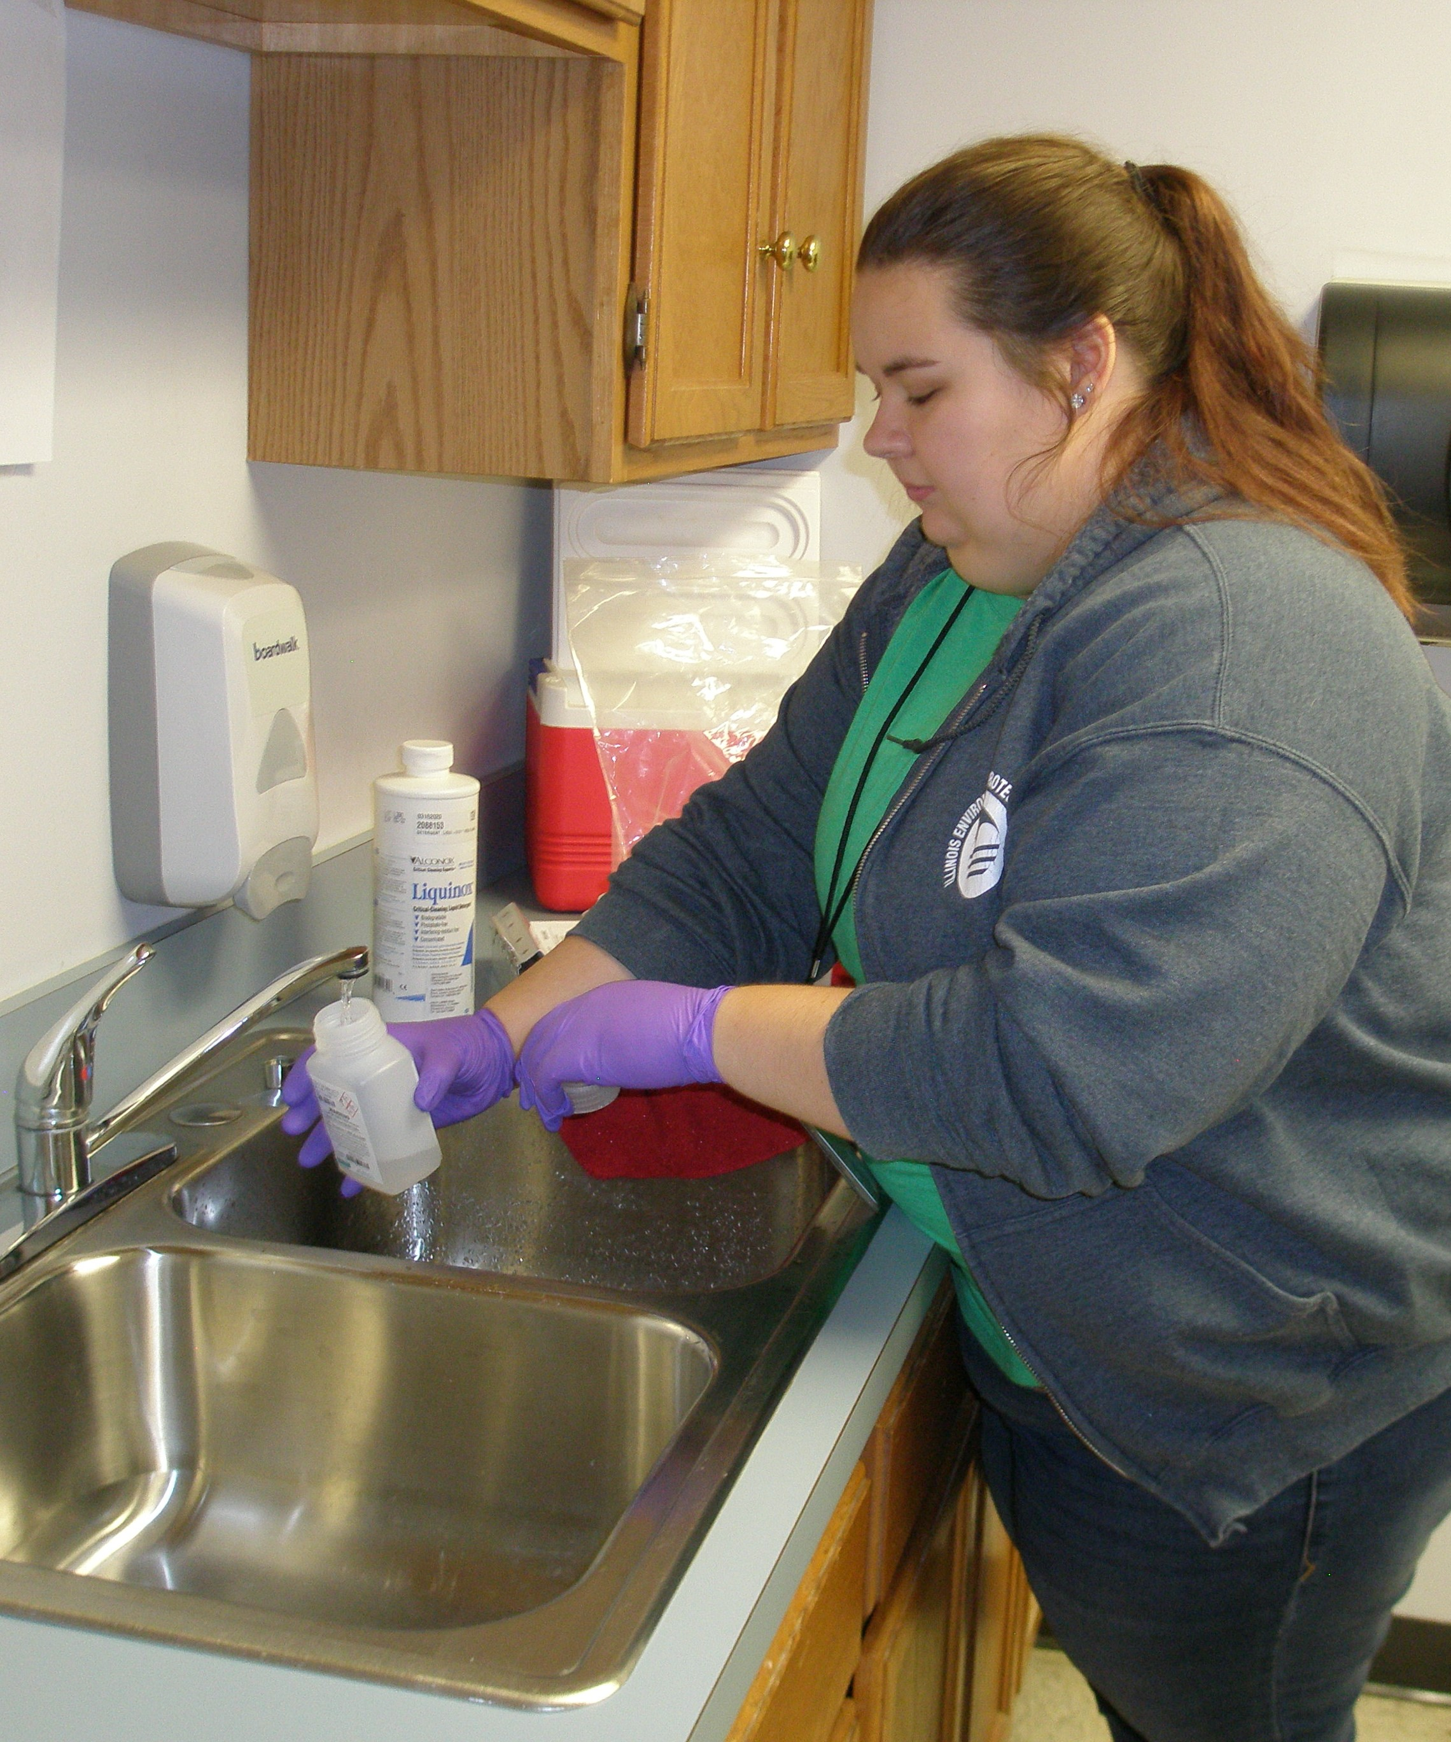
How Many Samples?
Total of 1,711 (includes quality-control samples) collected
1,428 initial field samples from entry points at 1,017 CWS.
164 confirmation samples
33 secondary confirmation samples
86 duplicate and confirmation duplicate samples
Staff geologist, Illinois Environmental Protection Agency (IEPA), collecting a sample. Photograph taken by Alan Fuhrman, IEPA.
15

Slide 16
Quality-control Sampling
Sample set: unfiltered field samples (two-250 milliliter polypropylene bottles) and a field reagent blank (FRB) (one bottle).
Precision and bias were measured by collecting field duplicates and laboratory fortified sample matrix (LFSM) per batch of 20 field sample sets.
86 samples were duplicate and confirmation duplicate samples.
72 initial field duplicate samples
14 detected PFAS in initial samples
14 detected PFAS in confirmation samples
75 LFSM/LFSMD
The results from the duplicate, FRB, and LFSM sample analyses were generally of acceptable precision and no indication of cross-contamination or matrix interference instances were evident.
(Dulka, A., and Rousey, M., 2020)
16
Notes:
7 sample sets exceeded the spike percent recovery upper limit of 150 percent (Michelle Rousey, IEPA Bureau of Water – Quality Control Officer, written commun., February 2022). In each instance, the exceedance in percent recovery was due to concentrations of PFAS in the associated field sample below the MRL (2 ng/L) but high enough to bias the LFSM/LFSMD result. These instances did not affect or further qualify the field sample results because the source of the high recovery was not related to matrix enhancement; rather, the high recovery was due to the native concentration of PFAS in the parent (field) sample.
The relative percent difference, calculated as the absolute difference in the field sample and duplicate sample concentrations divided by the mean of the two concentrations, was generally less than 10 percent for most of the results, with a few exceptions (table 3). One confirmation sample and associated duplicate sample from a CWS (IL1115700) had consistent differences between concentrations of PFBS (15 percent), PFHxA (23 percent), and PFOA (10 percent). There were no indications of any sample integrity issues for this sample noted in the dataset provided to the USGS. These larger percent differences may be from low concentrations of PFAS that are close to the detection limits (MRLs) using EPA Method 537.1
Sampling methods and Quality control
Sample collection methods followed the SOP contained in the IEPA QAPP (Dulka and Rousey, 2020; IEPA, 2020). According to the SOP and QAPP, each sample set from a unique entry point consisted of a minimum of an unfiltered field sample (two 250-milliliter polypropylene bottles) and a field reagent blank (FRB) (one bottle). Precision and bias were measured by collecting additional samples for field duplicates and laboratory fortified sample matrix (LFSM)/LFSM duplicate (LFSMD) per batch of 20 field sample sets. A total of 86 field duplicate samples and 75 LFSM/LFSMD samples were collected in this study.

Slide 17
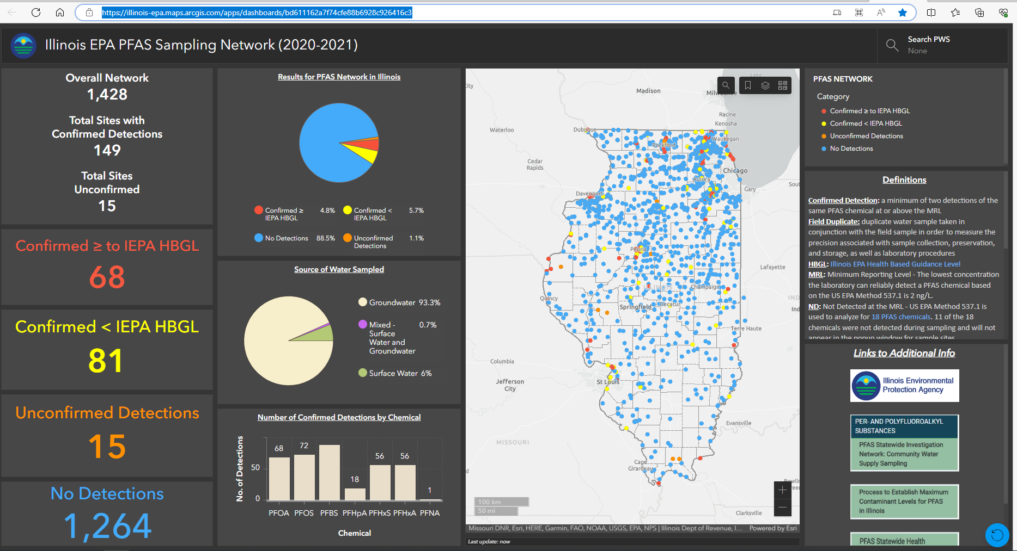
IEPA Database
https://illinois-epa.maps.arcgis.com/apps/dashboards/bd611162a7f74cfe88b6928c926416c3
17

Slide 18
PFAS by the Numbers
Total PFAS detected: 359
out of 1,428 samples
CWS with at least one PFAS: 149 (10 percent)
PFBS (6.2 percent)
PFOS (5 percent)
PFOA (4.8 percent)
25 ng/L
Most frequent:
150 ng/L
37 ng/L
PFHxS (4 percent)
140 ng/L
Highest concentration detected:
1.3 million resident (about 18 percent) are served by CWS systems that had at least one detection of PFAS above the minimum reporting level (MRL) of 2 nanograms per liter (ng/L)
18

Slide 19
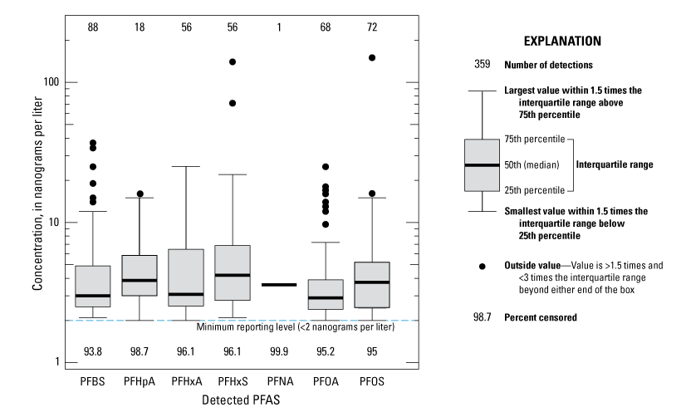
Gahala and others, 2023
19

Slide 20
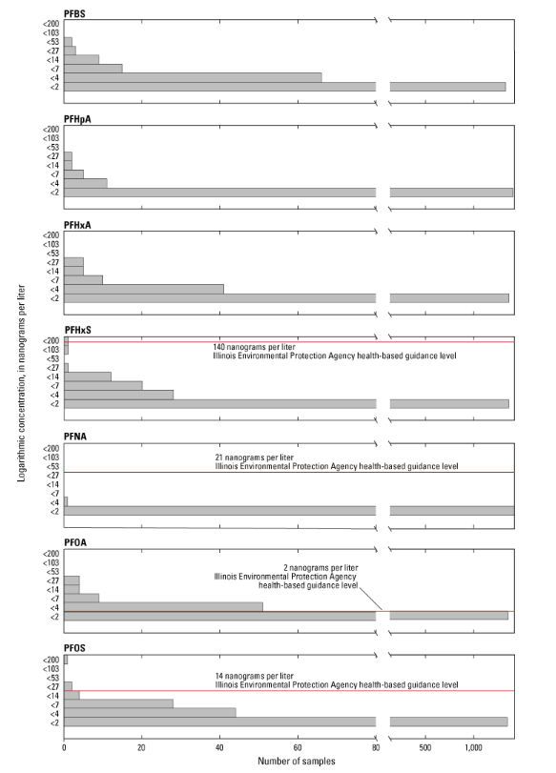
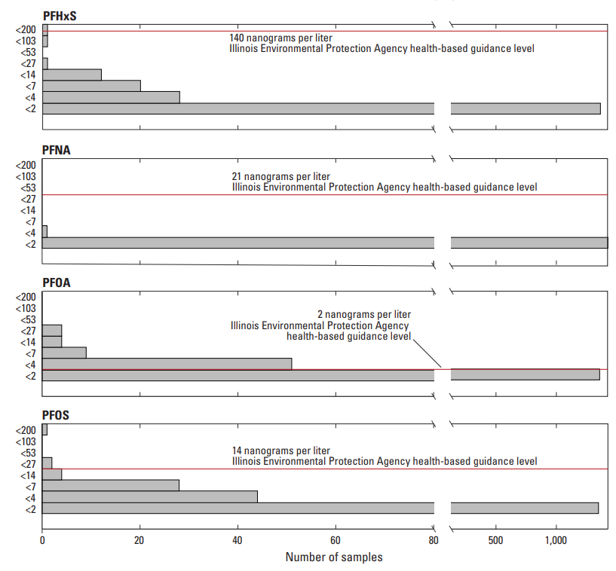
PFAS Concentration Bins
PFBS, PFOA, PFOS, PFHxA had highest number of detections equal to or greater than 2 but less than 7.
PFOA, exceeded Illinois EPA health-based guidance level (HBGL) in 68 samples
PFOS exceed HBGL of 14 ng/L in 3 samples
PFHxS exceeded HBGL in 1 sample.
Gahala and others, 2023
20

Slide 21
PFAS in Groundwater, Surface water, and Mixed Sources
Drinking Water Source | Number of CWS with at least one PFAS detected above minimum reporting level (2 ng/L) | Number of samples
Groundwater | 114 | 1333
Surface water | 30 | 85
Mixed | 5 | 10
Total | 149 | 1428
21

Slide 22
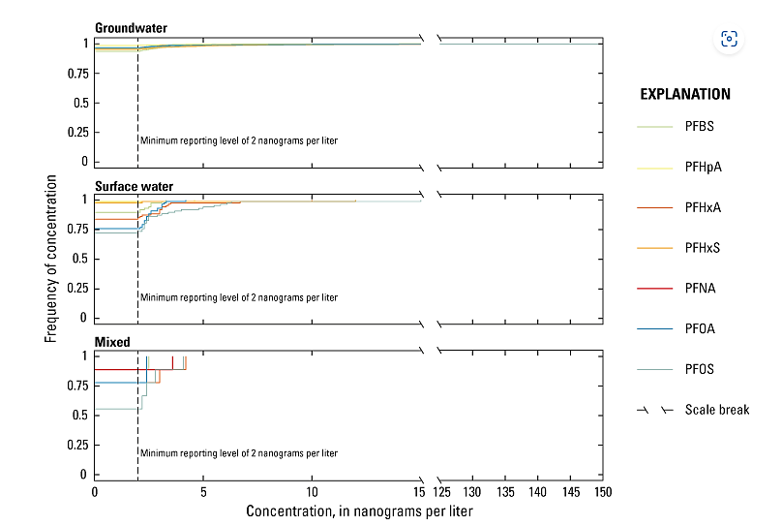
Statistically significant differences among the types of PFAS detected in GW, SW, or mixed sources:
PFOA, PFOS, and PFHxA
Gahala and others, 2023
22
Notes:
The cumulative distribution as a fraction of frequency for the seven PFAS detected throughout CWS systems in Illinois per drinking-water source is shown in figure 4. The results show groundwater has nearly equal distribution of the frequency of detections among the six PFAS detected, with greatest frequency occurring for PFBS and highest concentration (150 ng/L) occurring for PFOS. PFOS and PFOA were more frequently detected in surface water and mixed drinking-water sources, with lower concentrations than groundwater.

Slide 23
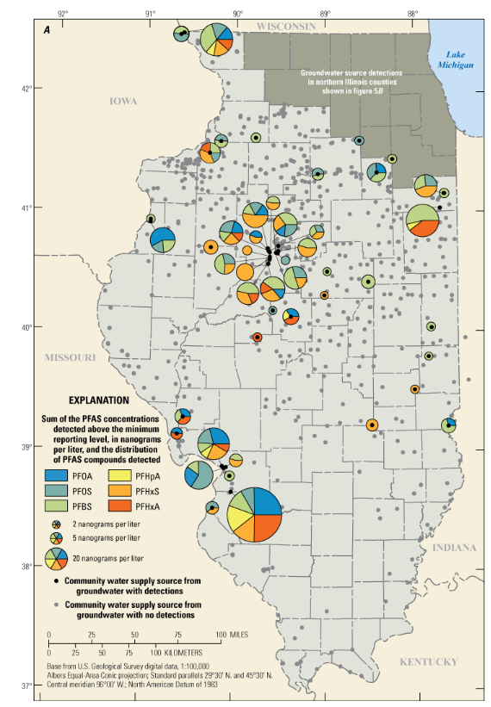
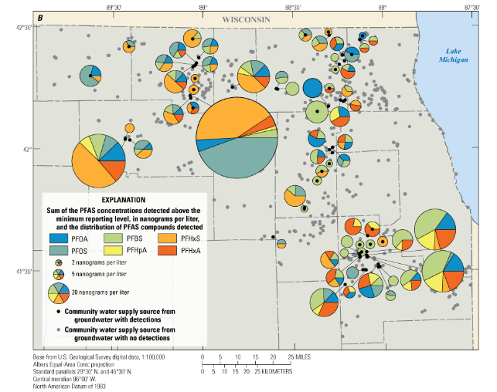
PFAS in Groundwater Sources
23
Gahala and others, 2023

Slide 24
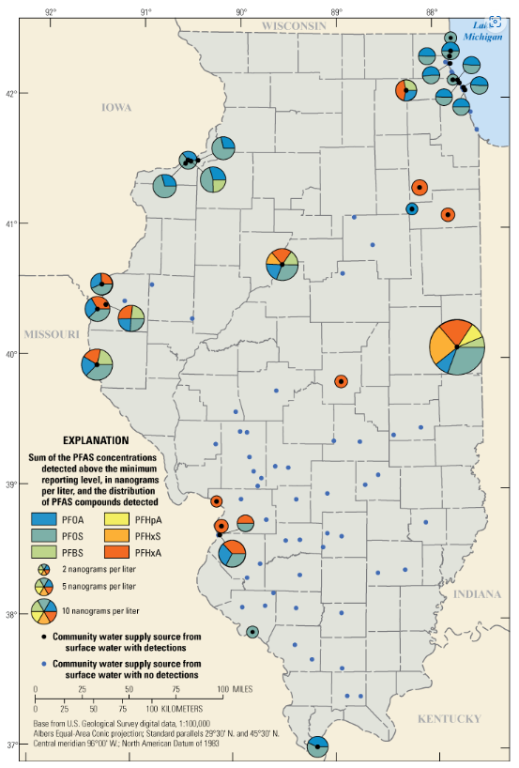
PFAS in Surface Water Sources
Gahala and others, 2023
24

Slide 25
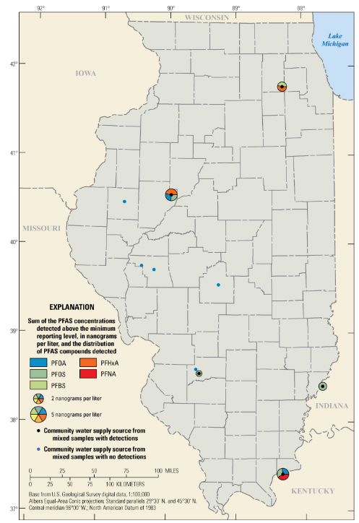
PFAS in Mixed Sources
Gahala and others, 2023
25

Slide 26
Distribution of PFAS among Drinking Water Sources
Groundwater
about 9 percent, 114 of 1,333
Surface water
about 35 percent, 30 of 85
2 to 150 ng/L
2 to 15 ng/L
Mixed
2 to 4.2 ng/L
50 percent, 5 of 10
Differences in water treatment methods between surface water and groundwater
Precursor compounds
Nonpoint sources
Point-sources
Dilution effects from surface-water sources
Longer travel times in groundwater systems
26

Slide 27
Summary
IEPA sampled and analyzed 18 PFAS using U.S. EPA method 537.1 at 1,428 entry points at active community water supply systems in Illinois.
7 of the 18 PFAS detected in 149 entry points.
1.3 million out of 7.4 million residents (about 18 percent) are served by CWS systems that had at least one detection of PFAS.
Most frequently detected: PFBS, PFOS, PFOA
Distribution of PFAS among drinking water sources indicate PFAS detections were more common in surface water and mixed and were at lower concentrations, whereas groundwater had a wider range of concentrations.
27

Slide 28
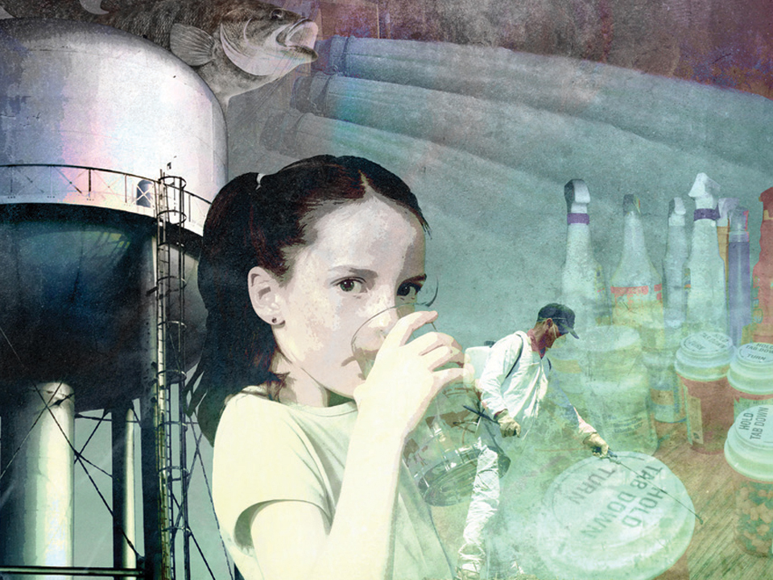
Acknowledgements: The authors wish to thank Michelle Rousey and Karen Bridges of the Illinois Environmental Protection Agency for their contributions to methods sections of the report.
Thank You!
Any questions?
Amy Gahala
agahala@usgs.gov
815-752-2044
28
Notes:
End Presentation, Questions?

Slide 29
Selected References Cited
Agency for Toxic Substances and Disease Registry [ATSDR], 2023, What are the health effects of PFAS? What are PFAS?: ATSDR webpage, accessed January 12, 2023, at https://www.atsdr.cdc.gov/pfas/health-effects/index.html.
Andrews, D.Q., Hayes, J., Stoiber, T., Brewer, B., Campbell, C., and Naidenko, O.V., 2021, Identification of point source discharges of per- and polyfluoroalkyl substances in the United States: AWWA Water Science, v. 3, no. 5, 16 p., accessed November 8, 2022, at https://doi.org/10.1002/aws2.1252.
Costello, E., Rock, S., Stratakis, N., Eckel, S.P., Walker, D.I., Valvi, D., Cserbik, D., Jenkins, T., Xanthakos, S.A., Kohli, R., Sisley, S., Vasiliou, V., La Merrill, M.A., Rosen, H., Conti, D.V., McConnell, R., and Chatzi, L., 2022, Exposure to per-and polyfluoroalkyl substances and markers of liver injury—A systematic review and meta-analysis: Environmental Health Perspectives, v. 130, no. 4, 27 p. [Also available at https://doi.org/10.1289/EHP10092.]
Conder, J.M., Hoke, R.A., de Wolf, W., Russell, M.H., and Buck, R.C., 2008, Are PFCAs bioaccumulative? A critical review and comparison with regulatory criteria and persistent lipophilic compounds: Environmental Science & Technology, v. 42, no. 4, p. 995–1003, accessed March 30, 2022, at https://doi.org/10.1021/es070895g.
Dulka, A., and Rousey, M., 2020, Quality assurance project plan—Per- and polyfluoroalkyl substances (PFAS) sampling in community water supplies: Illinois Environmental Protection Agency, Document Control No. 251, 49 p., available at
https://epa.illinois.gov/topics/water-quality/pfas/pfas-statewide-investigation-network.html
Illinois Environmental Protection Agency, 2023, PFAS statewide investigation network: Community Water Supply Sampling: Illinois Environmental Protection Agency website, accessed Sept. 2023 at https://epa.illinois.gov/topics/water-quality/pfas/pfas-statewide-investigation-network.html
National Toxicology Program, 2016, NTP monograph on immunotoxicity associated with exposure to perfluorooctanoic acid (PFOA) and perfluorooctane sulfonate (PFOS): U.S. Department of Health and Human Services, accessed August 10, 2022, at https://ntp.niehs.nih.gov/ntp/ohat/pfoa_pfos/pfoa_pfosmonograph_508.pdf.
Sohn, Y.S., Moon, S., and Park, Y.J., 2020, Effect of multiple exposure to perfluorinated chemicals on thyroid function among adults in the US—The national health and nutrition examination survey 2007–2008 and 2011–2012: International Journal of Thyroidology, v. 13, no. 1, p. 19–29, accessed September 1, 2022, at https://doi.org/10.11106/ijt.2020.13.1.19.
Peterson, A.K., Eckel, S.P., Habre, R., Yang, T., Faham, D., Farzan, S.F., Grubbs, B.H., Kannan, K., Robinson, M., Lerner, D., Al-Marayati, L.A., Walker, D.K., Grant, E.G., Bastain, T.M., and Breton, C.V., 2022, Prenatal perfluorooctanoic acid (PFOA) exposure is associated with lower infant birthweight within the MADRES pregnancy cohort: Frontiers in Epidemiology, v. 2, accessed September 1, 2022, at https://doi.org/10.3389/fepid.2022.934715.
Post, G.B., Cohn, P.D., and Cooper, K.R., 2012, Perfluorooctanoic acid (PFOA), an emerging drinking water contaminant—A critical review of recent literature: Environmental Research, v. 116, p. 93–117. [Also available at https://doi.org/10.1016/j.envres.2012.03.007.]
Schulte, L., 2022, Microbes deployed to eat toxic ‘forever chemicals’ at Madison [Wisconsin] airport show promising results: Milwaukee Journal Sentinel, accessed October 5, 2022, at https ://www.jso nline.com/ story/ news/ local/ wisconsin/ 2022/ 10/ 04/ microbes- so- far- successful- eating- up- toxic- pfas- dane- co- airport/ 8167875001/ .
Rickard, B.P., Rizvi, I., and Fenton, S.E., 2022, Per- and poly-fluoroalkyl substances (PFAS) and female reproductive outcomes—PFAS elimination, endocrine-mediated effects, and disease: Toxicology, v. 465, 153031, accessed September 1, 2022, at https://doi.org/10.1016/j.tox.2021.153031.
Trang, B., Li, Y., Xue, X.-S., Ateia, M., Houk, K.N., and Dichtel, W.R., 2022, Low-temperature mineralization of perfluorocarboxylic acids: Science, v. 377, no. 6608, p. 839–845, accessed October 5, 2022, at https://doi.org/ 10.1126/ science.abm8868.
29

